Slide 1
Tortoisegit starter guide

Slide 2
Git and SVN differences
Git is much faster than Subversion
Subversion allows you to check out just a subtree of a repository; Git requires you to clone the entire repository (including history) and create a working copy that mirrors at least a subset of the items under version control.
Git's repositories are much smaller than Subversions (for the Mozilla project, 30x smaller)
Git was designed to be fully distributed from the start, allowing each developer to have full local control
Git branches are simpler and less resource heavy than Subversion's
Git branches carry their entire history
Merging in Git does not require you to remember the revision you merged from (this benefit was obviated with the release of Subversion 1.5)
Git provides better auditing of branch and merge events
Git's repo file formats are simple, so repair is easy and corruption is rare.

Slide 3
Git major features over subversion
Distributed Nature
Access Control
Branch Handling
Performance (Speed of Operation)
Smaller Space Requirements

Slide 4
Puttygen

Slide 5
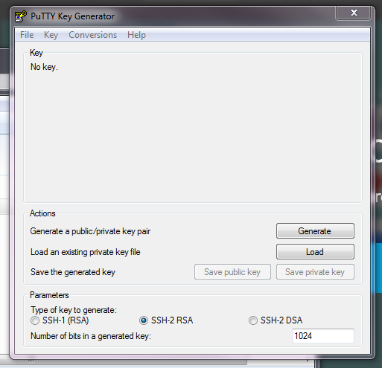
Open puttygen

Slide 6

Load private key

Slide 7

Select private key

Slide 8
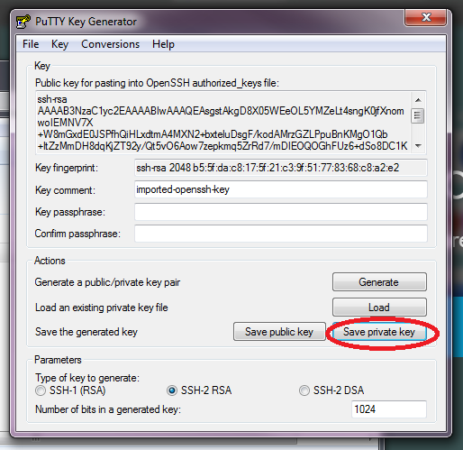
Save private key

Slide 9

Type filename

Slide 10
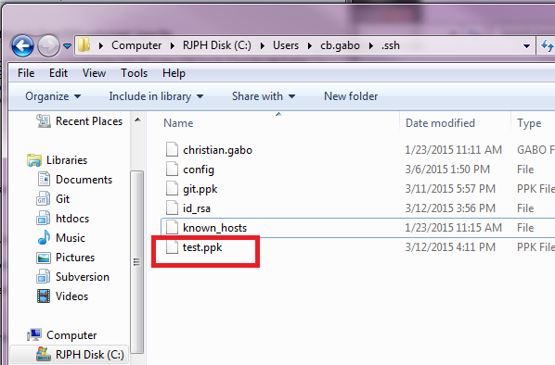
Output file

Slide 11
Cloning new repository

Slide 12
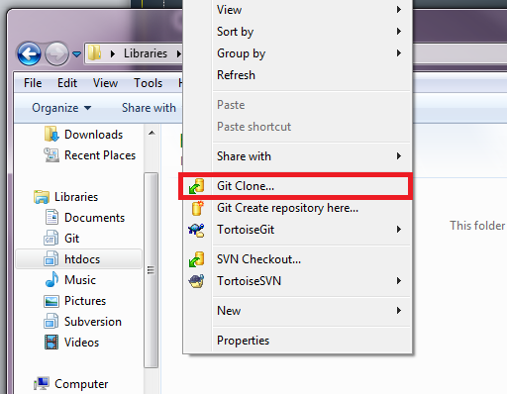
Select clone option

Slide 13
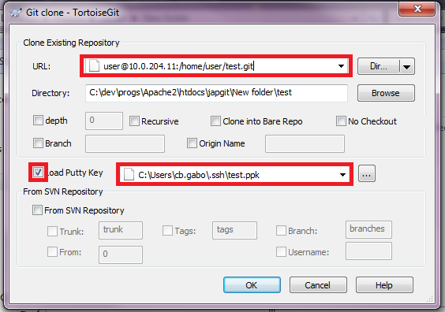
Indicate repo and private key

Slide 14

Cloning successful

Slide 15

Cloned folder

Slide 16
Committing and Pushing

Slide 17

Create new file

Slide 18
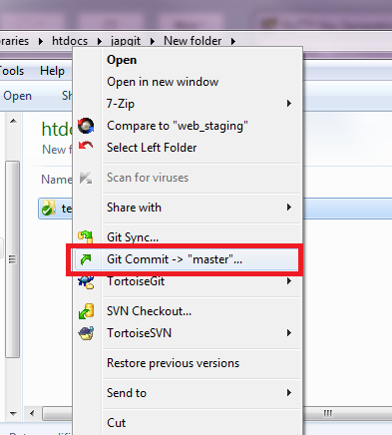
Select commit option

Slide 19
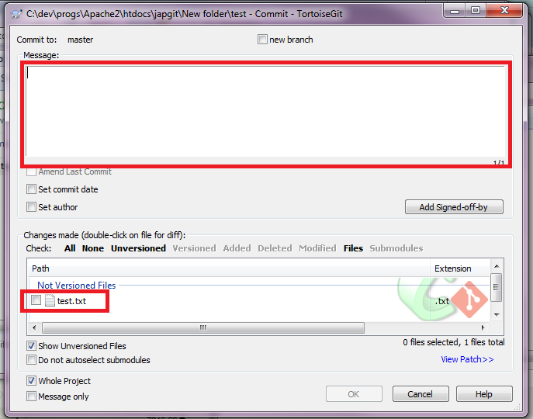
Add comments and select files

Slide 20
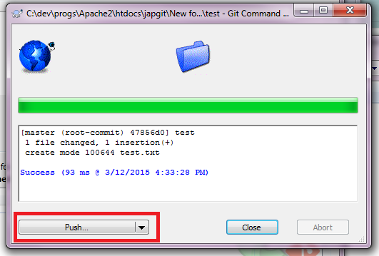
Select push

Slide 21
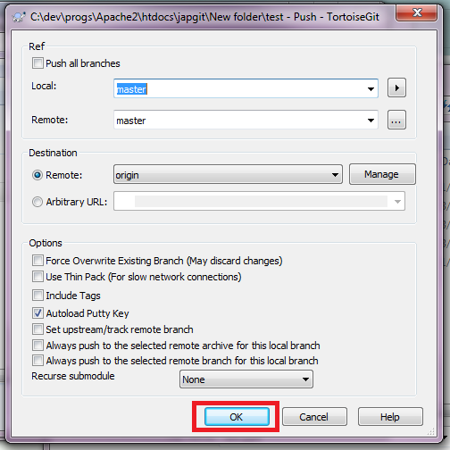
Review push menu

Slide 22
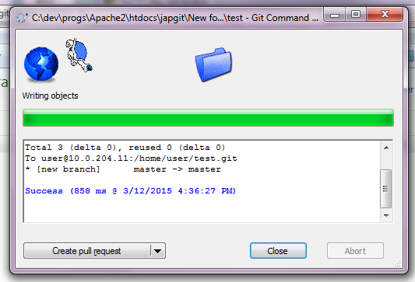
Pushing successful

Slide 23
Branching

Slide 24
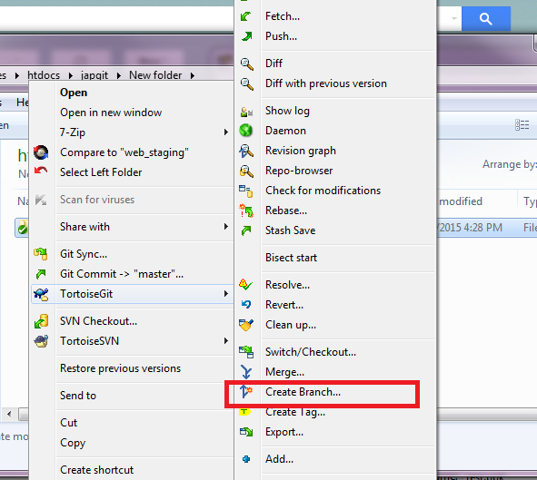
Create branch

Slide 25
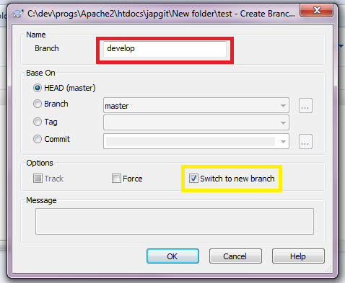
Branch menu

Slide 26

Create new file

Slide 27
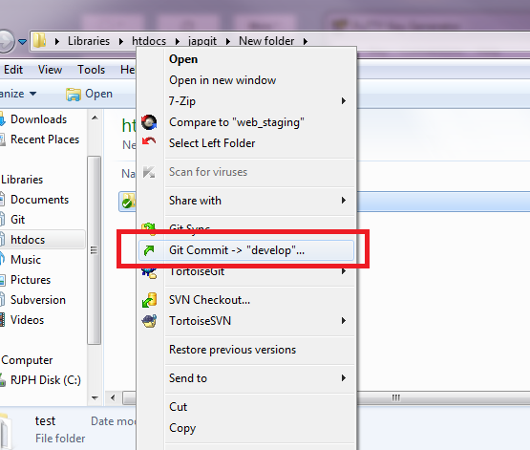
Commit to branch

Slide 28
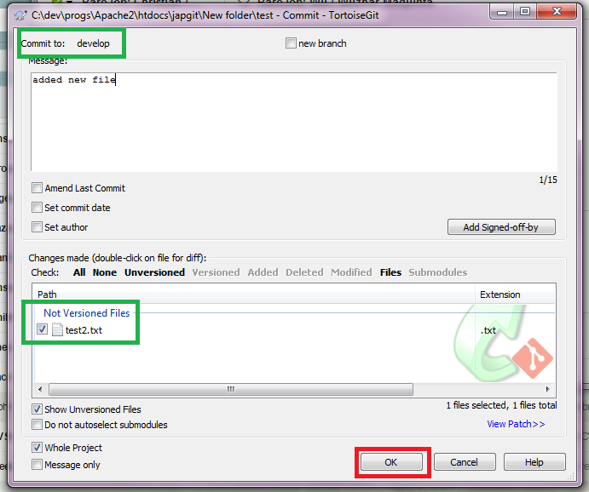
Commit confirmation

Slide 29
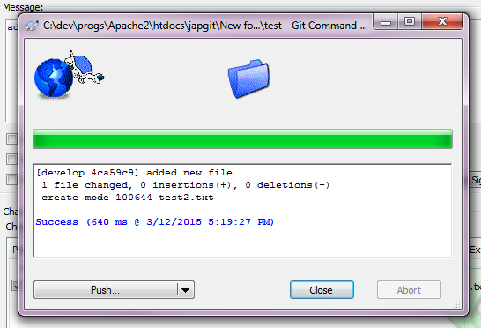
Push branch

Slide 30
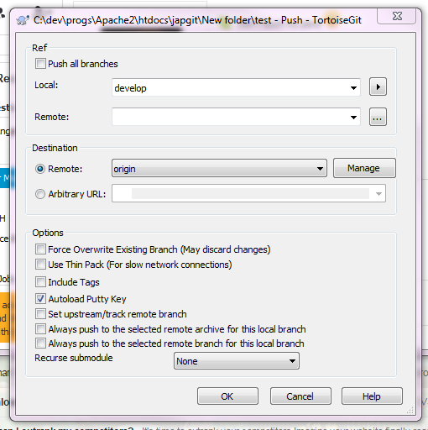
Review push menu

Slide 31
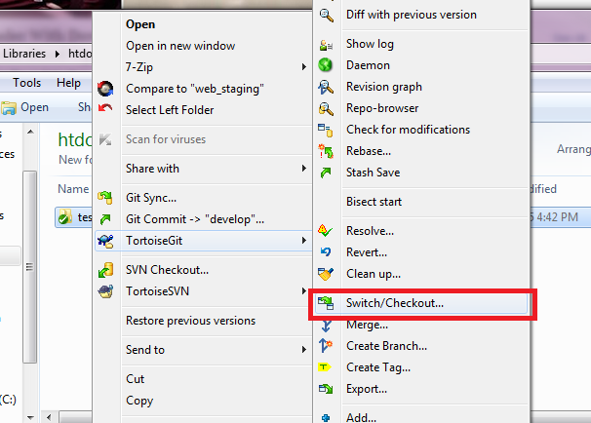
Checkout / Switch branch

Slide 32
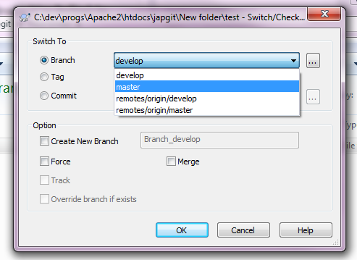
Select branch

Slide 33

Checkout result

Slide 34
Merging branches

Slide 35
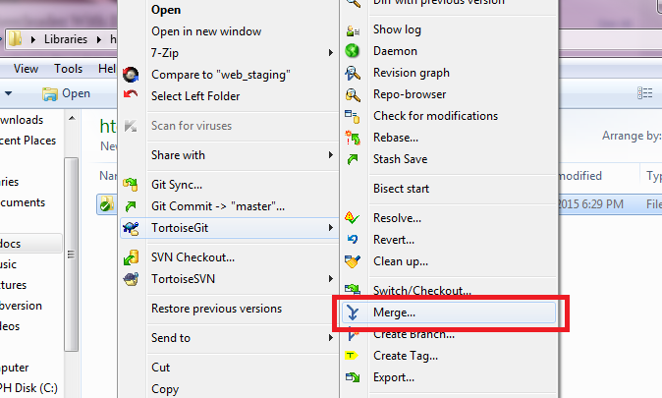
Select merge option

Slide 36
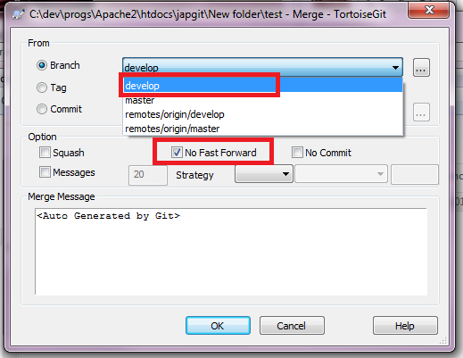
Select branch to merge with

Slide 37
http://Bit.ly/GitSvnCrashCourseCrashCourse

